Slide 1

Vel Tech Rangarajan Dr. Sagunthala R&D Institute of Science and Technology
School of Computing
Department of Computer Science and Engineering
10211CS224 / FULL STACK APPLICATION DEVELOPMENT (JAVA)
PROJECT REVIEW : MILESTONE PROJECT – 1
Date: DD-MM-YYYY
Relational Inventory Control & Stock Tracking System
SDG: SDG 12 - Responsible Consumption and Production
Presented By:
MARIA IMMANUEL L– VTU24334 – 23UECS0345
Courses Handling Faculty:
Dr. X. Arogya Preskila

Slide 2
INTRODUCTION
1
Inventory mismanagement is a common problem in many businesses, leading to stock shortages, overstocking, and financial losses.
Manual record-keeping systems often result in data inaccuracies and delayed updates.
This project focuses on developing a Relational Inventory Control and Stock Tracking System to address these challenges.
The system uses a structured relational database to store and manage product, supplier, and transaction data efficiently.
It enables real-time monitoring of stock levels and automated updates after purchases or sales.
By reducing human errors, the system improves accuracy and operational efficiency.
It also generates reports to support better decision-making.
Overall, the system provides a reliable and scalable solution for effective inventory management.
2
3
4
5
6
7
8
9

Slide 3
PROBLEM STATEMENT
1
Many businesses still rely on manual or semi-automated methods to manage inventory and track stock levels. These traditional approaches often lead to inaccurate records, stock mismatches, delayed updates, and financial losses. Lack of real-time visibility makes it difficult to monitor product movement and make timely decisions. Overstocking and stock shortages negatively affect customer satisfaction and operational efficiency.
Additionally, disconnected data storage systems create inconsistencies and redundancy. There is a clear need for a centralized and automated solution to manage inventory effectively. The system must ensure data accuracy, real-time updates, and proper tracking of stock transactions. Therefore, a reliable relational inventory control and stock tracking system is required to improve efficiency and reduce errors.
2
3
4
5
6
7
8
9

Slide 4
OBJECTIVES
1
To design and develop a dynamic web-based Relational Inventory Control & Stock Tracking System using HTML5, CSS3, ES6, and MySQL.
To implement database queries and server-side connectivity (PHP/Node.js with XAMPP/Tomcat) to manage, update, and display real-time inventory data efficiently.
2
3
4
5
6
7
8
9

Slide 5
PROPOSED SYSTEM
1
The proposed system is a web-based Relational Inventory Control and Stock Tracking System developed using HTML5, CSS3, ES6, and MySQL.
It provides a centralized platform to manage products, suppliers, stock entries, and sales transactions.
The system maintains data in a structured relational database to ensure accuracy and consistency.
It enables real-time stock updates whenever a purchase or sale is recorded.
Automated calculations reduce manual errors in quantity tracking and reporting.
The application allows users to view current stock levels and generate reports instantly.
It eliminates data redundancy and improves data integrity compared to manual record-keeping.
Overall, the system enhances efficiency, reduces stock mismanagement, and supports better decision-making.
2
3
4
5
6
7
8
9

Slide 6
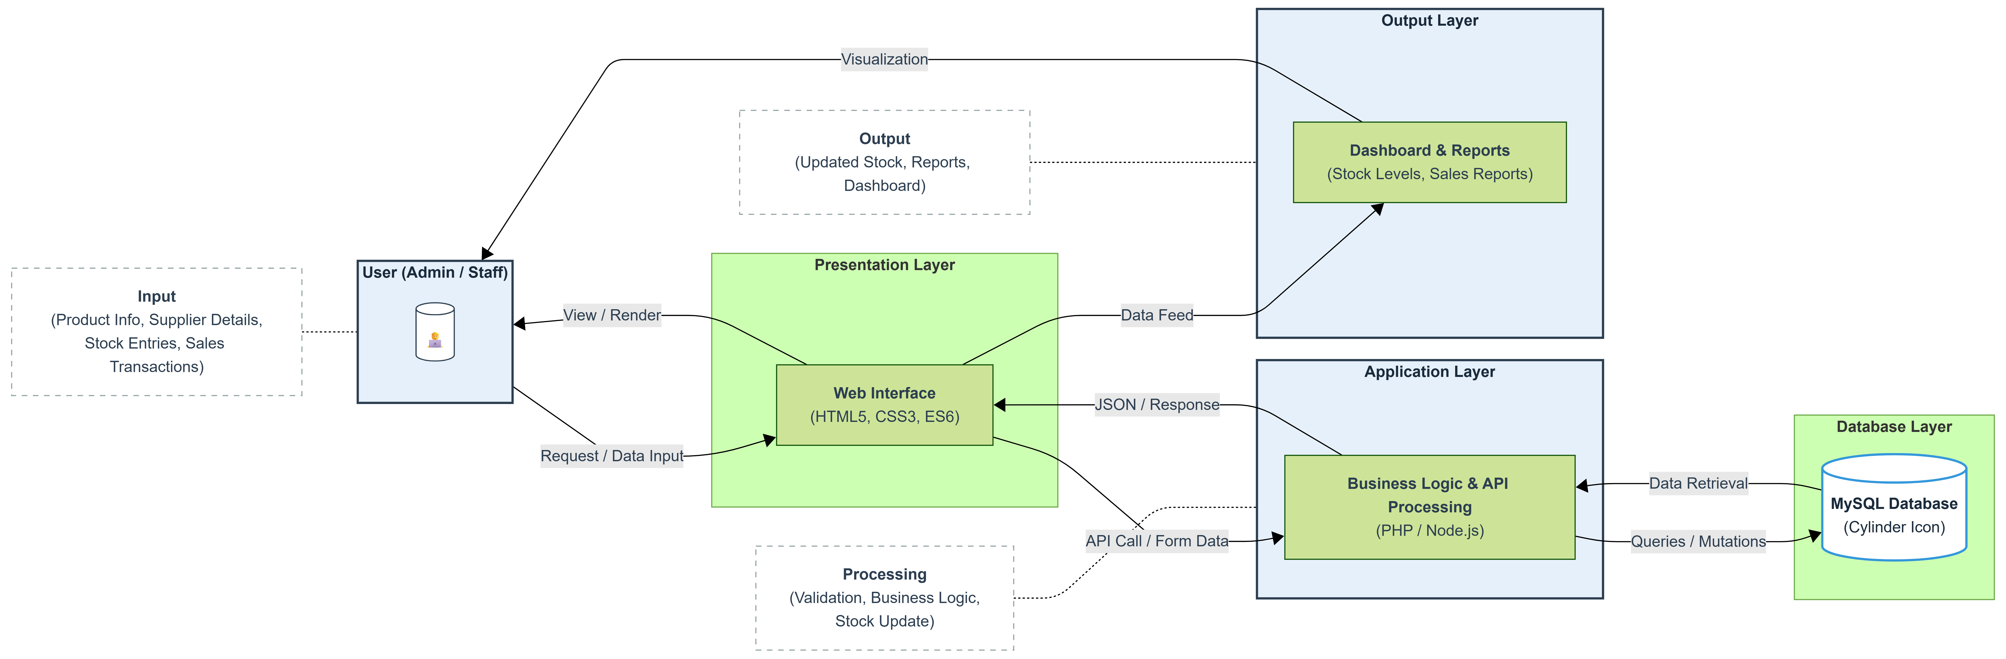
PROPOSED SYSTEM ARCHITECTURE
1
2
3
4
5
6
7
8
9

Slide 7
WORKFLOW
1
2
3
4
5
6
7
8
9

Slide 8
TECHNOLOGIES USED
1
Technologies Used :-
Frontend:
-> HTML5 | CSS3 | JavaScript (ES6)
Backend:
-> PHP / Node.js
Database:
-> MySQL
Tools:
-> XAMPP / Tomcat | VS Code | phpMyAdmin | Chrome
Hardware & Software Requirements:
-> Hardware: 4GB RAM, i3 Processor or above, 20GB Storage
-> Software: Windows 10/11 or Linux, MySQL Server, XAMPP/Node.js, Web Browser
2
3
4
5
6
7
8
9

Slide 9
MODULE DESCRIPTION
1
Module 1: Product & Inventory Management Module
This module manages CRUD (Create, Read, Update, Delete) operations for product records. It maintains stock quantity, product ID, category, pricing details, and availability status. Input validation and form handling are implemented using frontend technologies, while backend scripts process and update the database.
Module 2: Supplier & Transaction Processing Module
This module handles supplier data management and transaction processing (purchase and sales entries). It executes business logic to automatically increase or decrease stock levels based on transaction type. SQL queries are used to ensure accurate real-time updates and consistency.
Module 3: Database Management Module
This module manages relational database design, including table creation, primary and foreign key relationships, and normalization. It ensures data integrity, prevents redundancy, and handles secure data retrieval using structured queries.
Module 4: Reporting & Analytics Module
This module generates dynamic reports such as stock summaries, low-stock alerts, and transaction history. It retrieves processed data from the database and displays it through structured dashboards for analysis and decision-making.
2
3
4
5
6
7
8
9

Slide 10
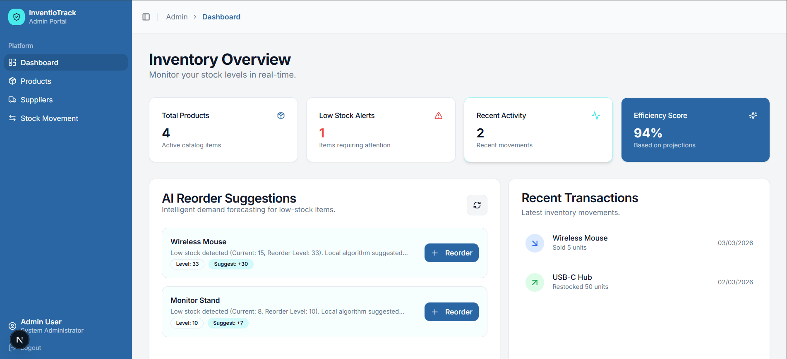
IMPLEMENTATION SCREENSHOTS
1
2
3
4
5
6
7
8
9

Slide 11
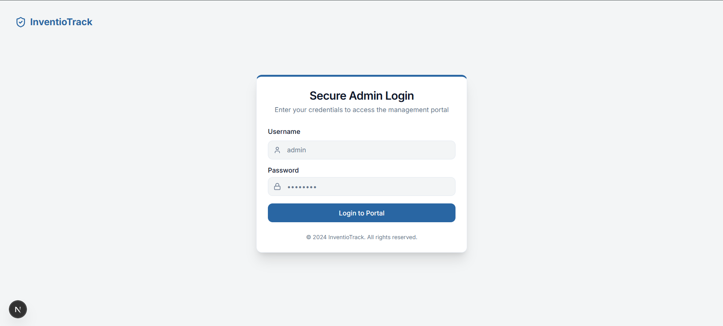
IMPLEMENTATION SCREENSHOTS
1
2
3
4
5
6
7
8(A)
9

Slide 12
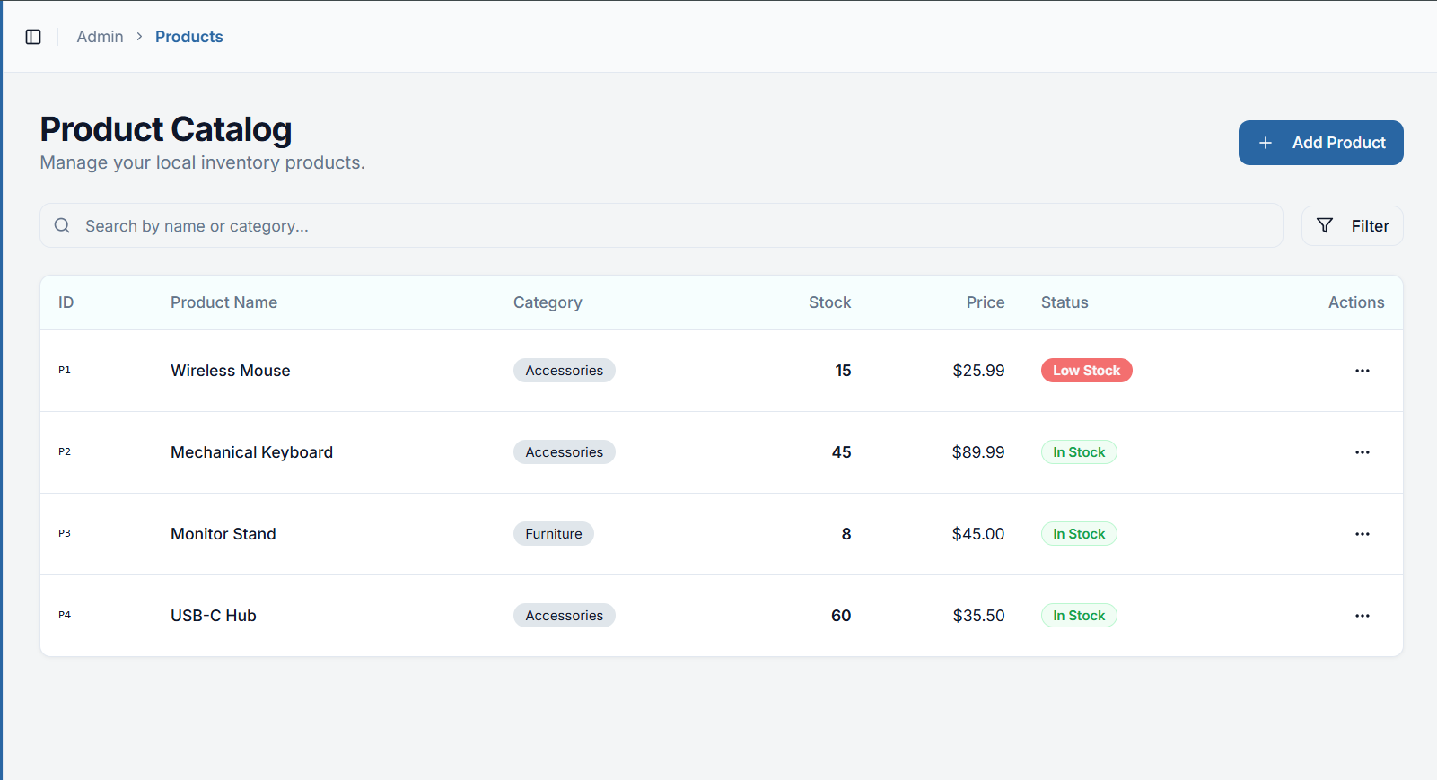
IMPLEMENTATION SCREENSHOTS
1
2
3
4
5
6
7
8(B)
9

Slide 13
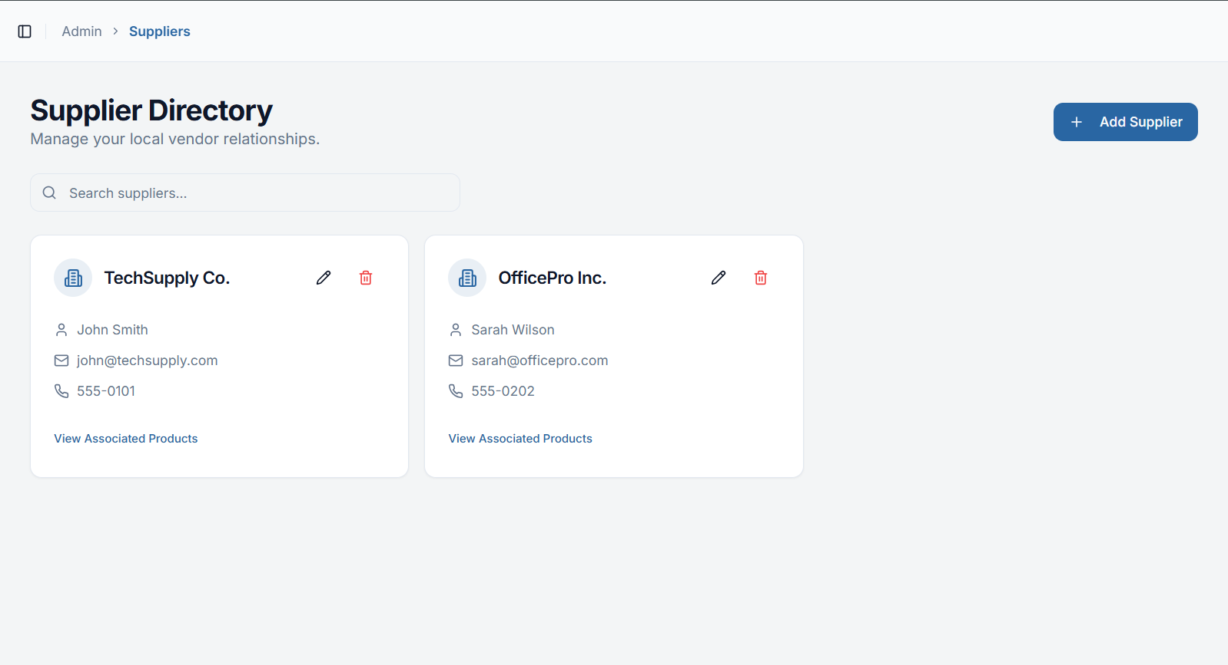
IMPLEMENTATION SCREENSHOTS
1
2
3
4
5
6
7
8(C)
9

Slide 14
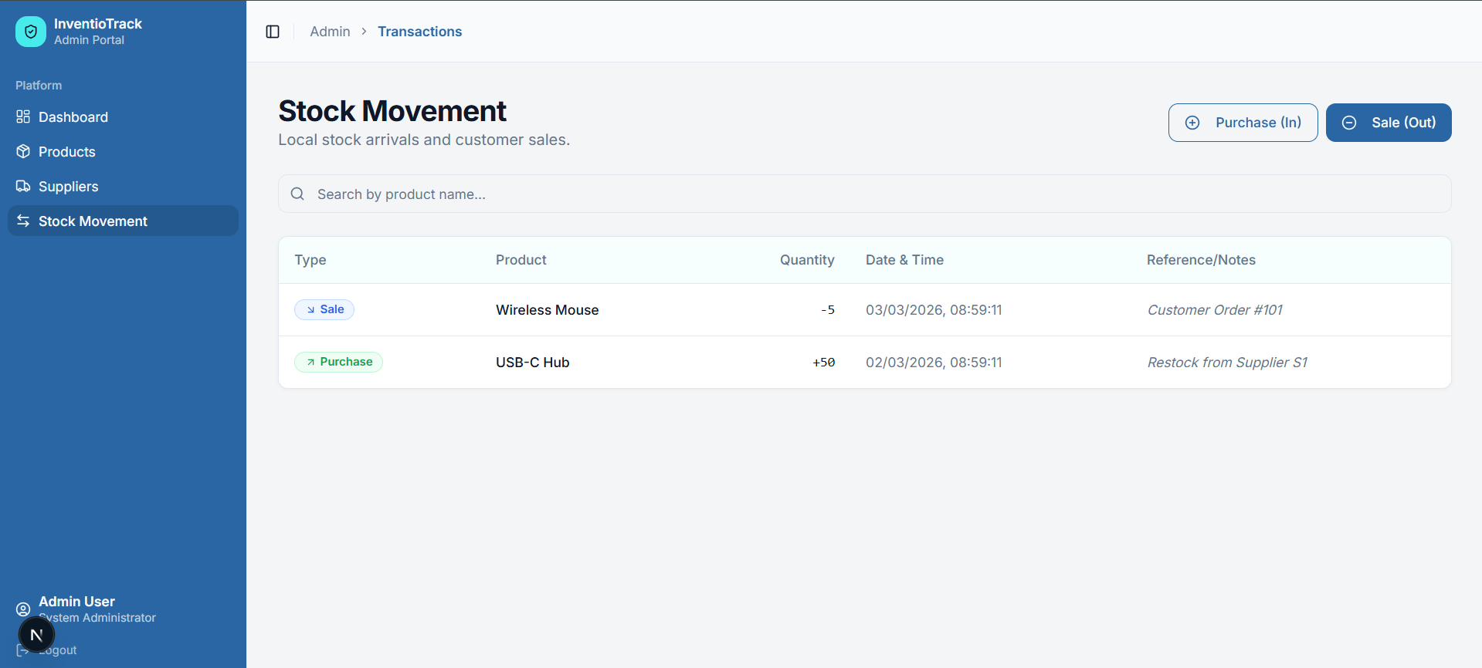
IMPLEMENTATION SCREENSHOTS
1
2
3
4
5
6
7
8(C)
9

Slide 15
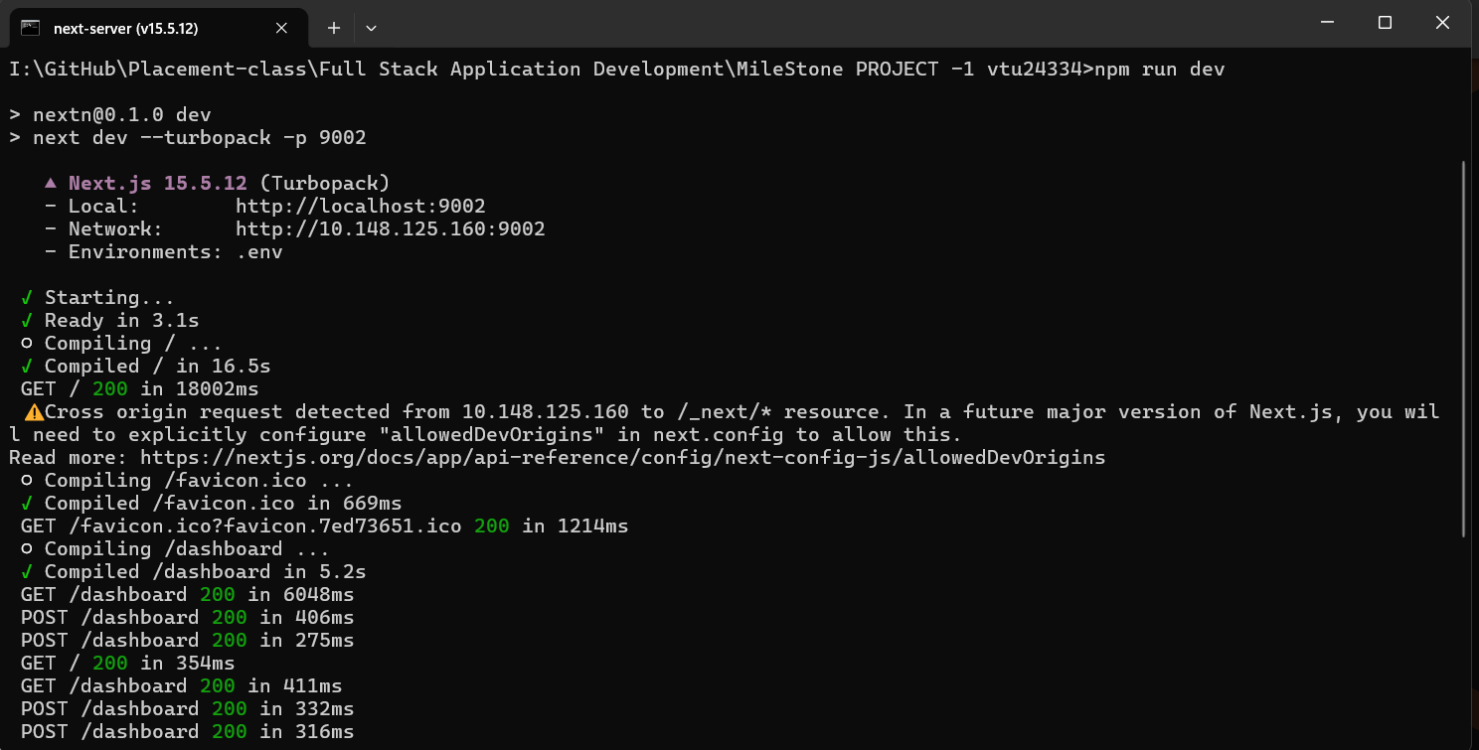
IMPLEMENTATION SCREENSHOTS
1
2
3
4
5
6
7
8(C)
9

Slide 16
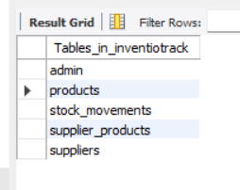
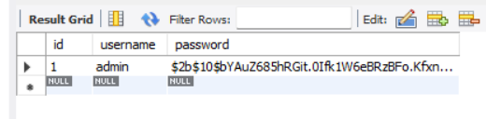
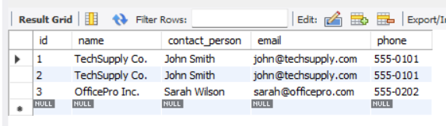
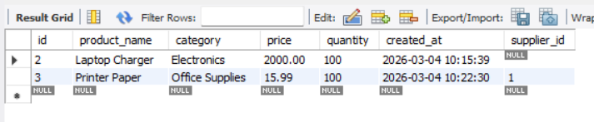
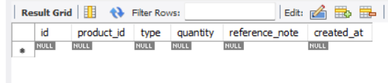
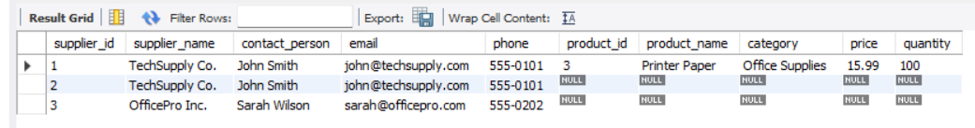
IMPLEMENTATION SCREENSHOTS
1
2
3
4
5
6
7
8(C)
9

Slide 17
ADVANTAGES & LIMITATIONS
1
ADVANTAGES :
-> Provides real-time stock monitoring and accurate inventory tracking.
-> Reduces manual errors through automated stock updates.
-> Improves data integrity using a relational database structure.
-> Enables quick report generation for better decision-making.
-> Centralized system improves efficiency and data accessibility.
-> Scalable design suitable for small and medium businesses.
LIMITATIONS :
-> Requires basic technical knowledge for system maintenance.
-> Dependent on internet/server availability for access.
-> Initial setup and database configuration may take time.
-> Limited to the features implemented (may not include advanced ERP functions).
-> Data security depends on proper server configuration and user authentication mechanisms.
2
3
4
5
6
7
8
9

Slide 18
Thank you

